Slide 1
Microsoft RemoteFX: Rich Windows Desktop Experience for VDI and Session Virtualization
Required Slide
SESSION CODE: VIR305
Karthik Lakshminarayanan
Group Program Manager - RemoteFX
Microsoft Corporation

Slide 2
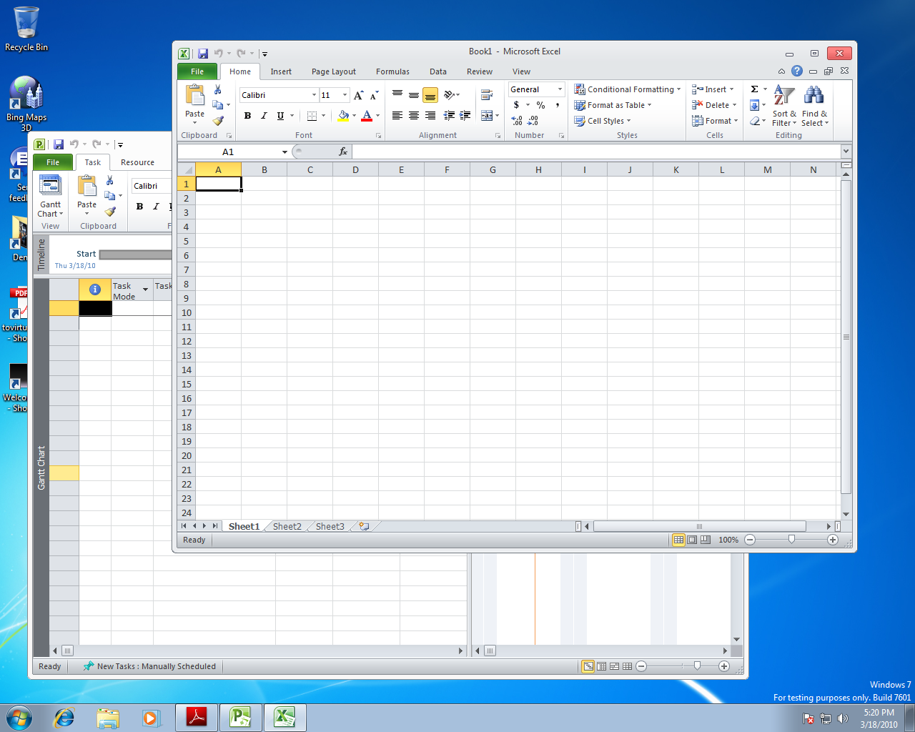

Slide 3
Agenda
Background and Trends
RemoteFX for VDI
Value Proposition
Architecture and Technology Deep Dive
RemoteFX for the IT Pro
RemoteFX for RDSH (formerly Terminal Server)
Ecosystem

Slide 4
VDI Background and Trends

Slide 5
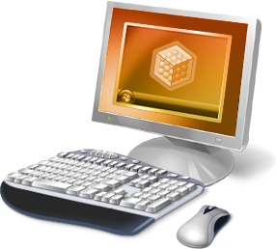
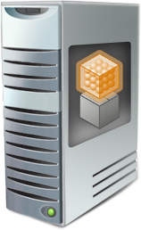
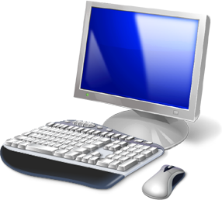

VDI Gaining Interest and Momentum
Lessons and experience with server virtualization is leading to trials of virtualized desktops.
New influences in regulatory requirements, a trend toward green computing, and flexibility of work environment is driving towards virtualization of the desktop.
VDI is predicted to grow quickly over the next five years.

Slide 6
The Technology Tipping Point?
Infrastructure
VM isolation enables full desktop centralization
Processor evolution shifts from clock speed to massive parallelism
Faster networks
Increased diversity of client devices
Graphics related trends
Graphics Richness Increasing: Media, 3D UI, Video, Animations, Flash, Silverlight
Increasing Fragmentation of Graphics Stacks
Portable Graphics stacks like Silverlight and Flash Emit as Flattened Bitmaps

Slide 7
RemoteFX for VDI

Slide 8
New Concept for RDP 7.1 for VDI
RDP Client Rendering
RDP Host Rendering
Separate host intercept for each graphics stack & client equivalents – gaps
Single intercept point for all graphics – predictable and complete UX
Leverages Rich Client HW and SW
Lightweight Clients means complexity is shifted to Host
Can lead to better bandwidth utilization for intercepted graphics types
Typically requires more bandwidth as traffic is sent as compressed bitmaps

Slide 9
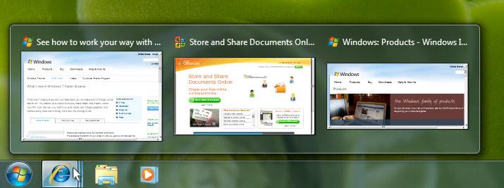


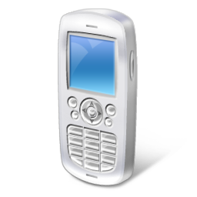
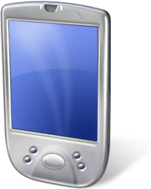

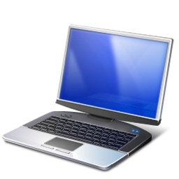
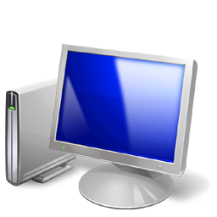
RemoteFX Value Proposition
Enabling Technology
Customer Value
Differentiating Innovation
Full rich Windows experience
Content and GPU independent intercept & rendering
Single GPU for multiple Hyper-V guests
VGPU
Remoting any content
Applications run at full-speed on host
Host side rendering
Screen deltas sent to client based on network and client availability
High fidelity user experience
Intelligent screen capture and hardware-based encode
CODEC designed for text and image content
Single CODEC for VDI and TS
HW and software manifestations by design
Full range of client devices
Bitmap remoting and hardware-based decode

Slide 10
Hyper-V VDI + RemoteFX Components
WS08 R2 SP1 Hyper-V Server
Inter-VM Communications
Hyper-V Parent Partition
Hyper-V
Integrated Shared Memory
Comms
RDP
Protocol Fundamentals (e.g. Authn, Encryption)
W7 SP1 Guest OS
VGPU output rendered to physical GPU via DirectX.
Screen deltas captured from GPU.
First phase of CODEC runs on GPU.
vGPU (WDDM) driver exposes parent GPU to guest OS.
RCC
VGPU Driver
VMBUS
GPU
RemoteFX Hardware ASIC and Driver
Optionally offloads CODEC from CPU/GPU increasing fidelity and scale.

Slide 11
RemoteFX Virtual GPU and Rendering Pipeline
Hyper-V VM Bus Parent Integration
D3D9 Application
IE
Silverlight ActiveX Control
RCC
Hyper-V VMBUS
Shared Memory
Comms
Hyper-V Parent Partition
DX9 APIs
GDI
W7 Child Partition
DX9 APIs
RemoteFX VGPU Driver
GPU Vendor Driver
Hyper-V VM Bus Child Integration
GPU

Slide 12
RemoteFX Capture and Encoding Pipeline
Hyper-V VM Bus Parent Integration
RDP
RDP
RCC
Hyper-V VMBUS
Shared Memory
Comms
Hyper-V Parent Partition
W7 Child Partition
DX10 APIs
RemoteFX VGPU Driver
GPU Vendor Driver
RemoteFX ASIC Driver
Hyper-V VM Bus Child Integration
GPU
ASIC

Slide 13
Leverages RDP Protocol Structure
RemoteFX payload
Graphics Virtual Channels (VCs)
Mouse & Keyboard VCs
Device
VCs
Partner
Virtual Channel
Plug-Ins
Virtual Channel Multiplexing and Framing
Bulk Compression (RDP5+, RDP6.0, RDP6.1)
Security Layer (SSL/Kerberos/NTLM)
Transport Layer (e.g. TCP, RPC/HTTP, Windows Live Tunnel)

Slide 14
RDP 7.1 Client Components and Graphics Pipeline
Core Services
Networking/
Security
Virtual Channels
Devices
Bulk Decompress
Key/Mouse
RemoteFX
Decode Abstraction Layer
SW Decoder
GPU
CPU
Display Device
RDP
RDP Client Components
HW Decode Driver
CA Decode ASIC

Slide 15
RemoteFX for VDI – Near Local Desktop Experience for the End User
DEMO

Slide 16

Deployment Considerations
Simple integration with inbox tools
Server Manager
Hyper-V Manager – shows up as a 3D video adapter
WMI, Power shell support
Performance and Scale
Performance whitepaper, planning and deployment guides available by SP1 RTM
Migration
RemoteFX for VDI is targeted at new deployments
New HW requirements [SLAT Processors, GPUs] require new servers
GPUs can be internal or external [e.g. appliance]
Can have a mix of RemoteFX enabled and non-RemoteFX VMs on the same server
Supports Live Migration across servers – requires identical GPUs

Slide 17
GPUs in the Datacenter?
OEM HW Available Today
Server Support
Future: Blades and Integrated Graphics
3D & The Modern Desktop
Aero Glass
IE9, HTML 5
Office 2010
WPF
Enterprise GPUS
Workstation Graphics
Compute Clusters
VDI!

Slide 18
RemoteFX for VDI – Configuring RemoteFX using Familiar Windows Server Tools
DEMO

Slide 19
RemoteFX for Remote Desktop Session Host (RDSH)

Slide 20
RemoteFX for RDSH
Session 0
Session [1…n]
TS Core
IE
Office
Other
LSM
TERMSRV
RDPWSX
GDI
User
Windows Server with RDSH Enabled
Kernel
RDP Core
WIN32K.SYS
TERMDD
RDPWD
RDPDD (RDP Display Driver)
HW Encode Driver
RDP
TDTCP
RemoteFX Encode Library
CPU
Encode ASIC

Slide 21
RemoteFX Ecosystem

Slide 22
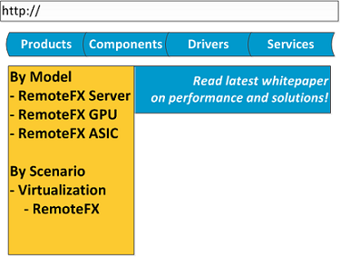
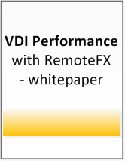
RemoteFX Servers from OEMs
At release, Customers can choose preconfigured RemoteFX servers and hardware from major OEMs
At release, Partners are ready with their arsenal of solutions and support.
Getting and maintaining RemoteFX Servers is dead simple.

Slide 23
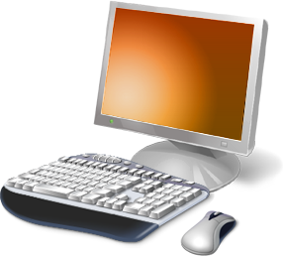
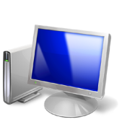
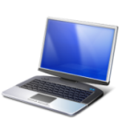
RemoteFX Clients
Windows/Non-Windows Embedded OS
Limited SW Graphics Stack and
Limited GPU
Legacy PC
Full SW Graphics Stack and Legacy
GPU
Breadth of Client Devices
Rich PC Thin Clients (e.g. Windows Embedded)
Full SW Graphics Stack and Optional Modern GPU
New Laptop
Full SW Graphics Stack and Modern
GPU

Slide 24
Ultra Lightweight Thin Clients
New class of Thin Client
ARM, MIPS, or PPC based designs
Running Windows CE, Linux, or other embedded OS
Support USB Redirection (true for all remote client types)
Lower client resources
CPU: 200 – 400 MHz
Memory: < 256MB RAM, < 128MB Flash
Less than 5w
Leverage HW CODEC acceleration
Customer Value: Purpose built low cost, low power device

Slide 25
In Closing
IT Pros: Evaluate RemoteFX for your VDI needs
If you are migrating to Windows 7, will your end users want the modern experience tomorrow?
Ordering Server configurations with 1 or more PCIe slot(s) allows for GPUs tomorrow
Use the Beta of Windows Server 2008 R2 SP1 and Windows 7 SP1
Ecosystem:
Consider becoming a RemoteFX Hardware or ISV Partner
Thank you for your time today!

Slide 26
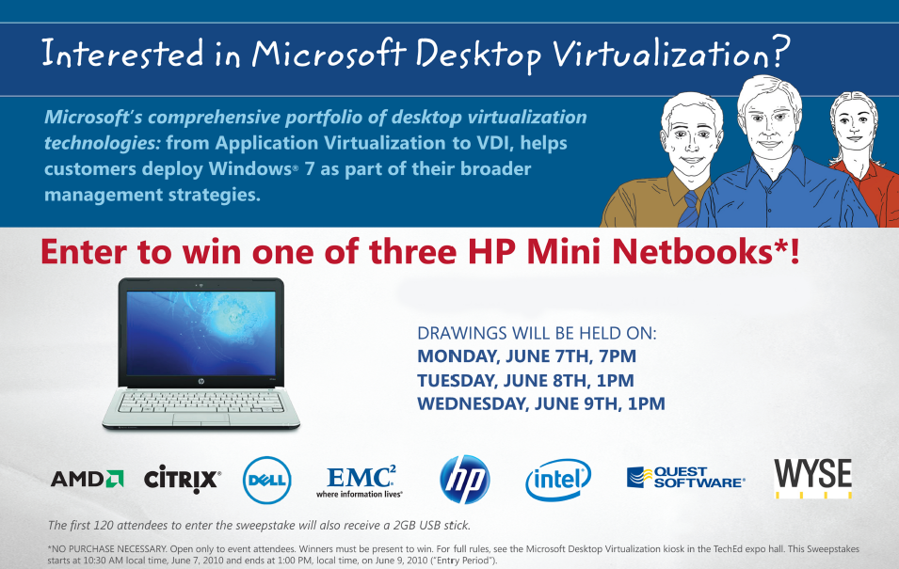
Interested in Learning More about Desktop Virtualization?
Visit the Desktop Virtualization kiosk in the TLC area to learn more and take part in our sweepstake. More resources are also available at:
www.DesktopVirtualizationHour.com

Slide 27

Related Content
Required Slide
Speakers, please list the Breakout Sessions, Interactive Sessions, Labs and Demo Stations that are related to your session.
VIR311 - Planning and Deploying Microsoft VDI with Management Technologies
WSV205- Remote Desktop Services: Virtual and Session-Based Desktops and Applications Architecture with Partners
WSV309 - Microsoft RemoteFX: USB and Device Support
WSV13-INT - Next Generation VDI with Microsoft RemoteFX

Slide 28

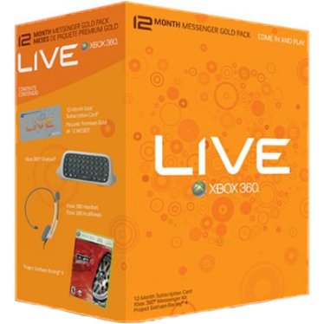

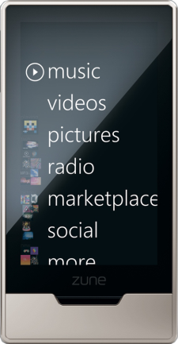
Required Slide
Complete an evaluation on CommNet and enter to win!

Slide 29


© 2010 Microsoft Corporation. All rights reserved. Microsoft, Windows, Windows Vista and other product names are or may be registered trademarks and/or trademarks in the U.S. and/or other countries.
The information herein is for informational purposes only and represents the current view of Microsoft Corporation as of the date of this presentation. Because Microsoft must respond to changing market conditions, it should not be interpreted to be a commitment on the part of Microsoft, and Microsoft cannot guarantee the accuracy of any information provided after the date of this presentation. MICROSOFT MAKES NO WARRANTIES, EXPRESS, IMPLIED OR STATUTORY, AS TO THE INFORMATION IN THIS PRESENTATION.

Slide 30
RemoteFX for VDI – Modern Windows 7 Desktop from an Ultra Lightweight RemoteFX Client
DEMO

Slide 31
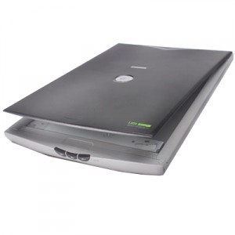
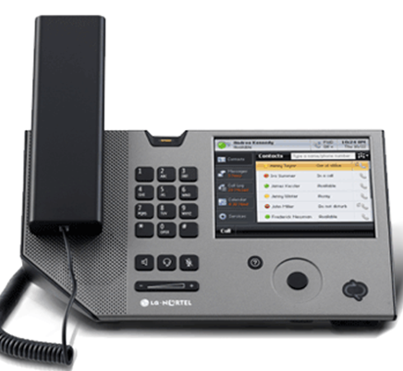
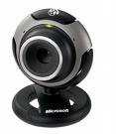
RemoteFX USB Device Redirection
Redirects devices at the USB Request Block (URB) Level
No client drivers necessary
One method that works with many devices
Only one session can use a USB device at a time
Optimized for the LAN
And many more…

Slide 32




Resources
Required Slide
Learning
Sessions On-Demand & Community
Microsoft Certification & Training Resources
www.microsoft.com/teched
www.microsoft.com/learning
Resources for IT Professionals
Resources for Developers
http://microsoft.com/technet
http://microsoft.com/msdn

Slide 33
Required Slide

